Slide 1
Singleton Pattern: A Chat Server
CS510 - Advanced UNIX/LINUX Programming
Instructor: Dr. Bhaskar, Vidhyacharan
Student: Chufeng Jiang 19949
Github:
https://github.com/Chufeng-Jiang/Cluster_ChatServer

Slide 2
Software Development Environment
Ubuntu 20.04
MySQL
VS Code
g++
cmake
libs:
muduo (2.0.2), nlohmann/json(3.7.3), boost(1.85.0)

Slide 3
Project Description
This project is a mimicry of What's app.
The server will accept commands from clients applications that connect to it.
It holds the chat rooms, dispatches the messages sent by clients, and supports direct messages between clients.
Functions：
Registration
Login
1-1 Chat
Offline Messages
TO DO:
Add Friends
Group Chat
Client Side
Cluster Setup

Slide 4
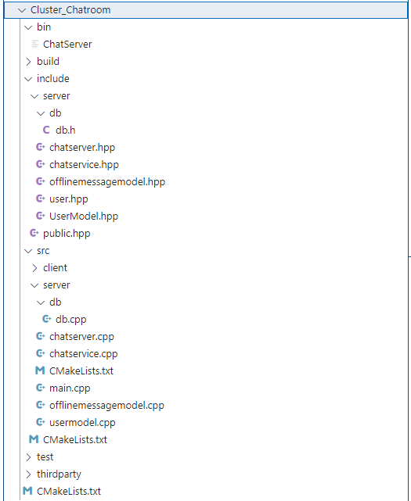
Project Structure
cmake_minimum_required(VERSION 3.0)
project(chat)
set(CMAKE_CXX_FLAGS "${CMAKE_CXX_FLAGS} -g")
set(EXECUTABLE_OUTPUT_PATH ${PROJECT_SOURCE_DIR}/bin)
include_directories(${PROJECT_SOURCE_DIR}/include)
include_directories(${PROJECT_SOURCE_DIR}/include/server)
include_directories(${PROJECT_SOURCE_DIR}/include/server/db)
include_directories(${PROJECT_SOURCE_DIR}/thirdparty)
add_subdirectory(src)

Slide 5
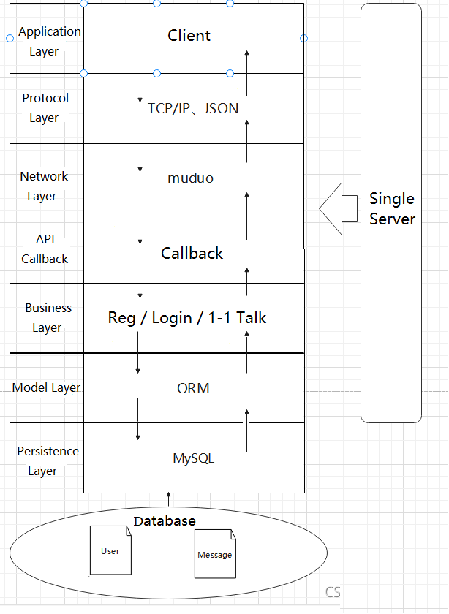
Software Architecture

Slide 6
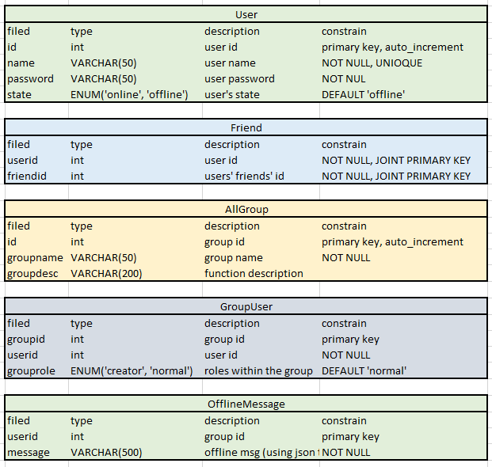
Database Design

Slide 7
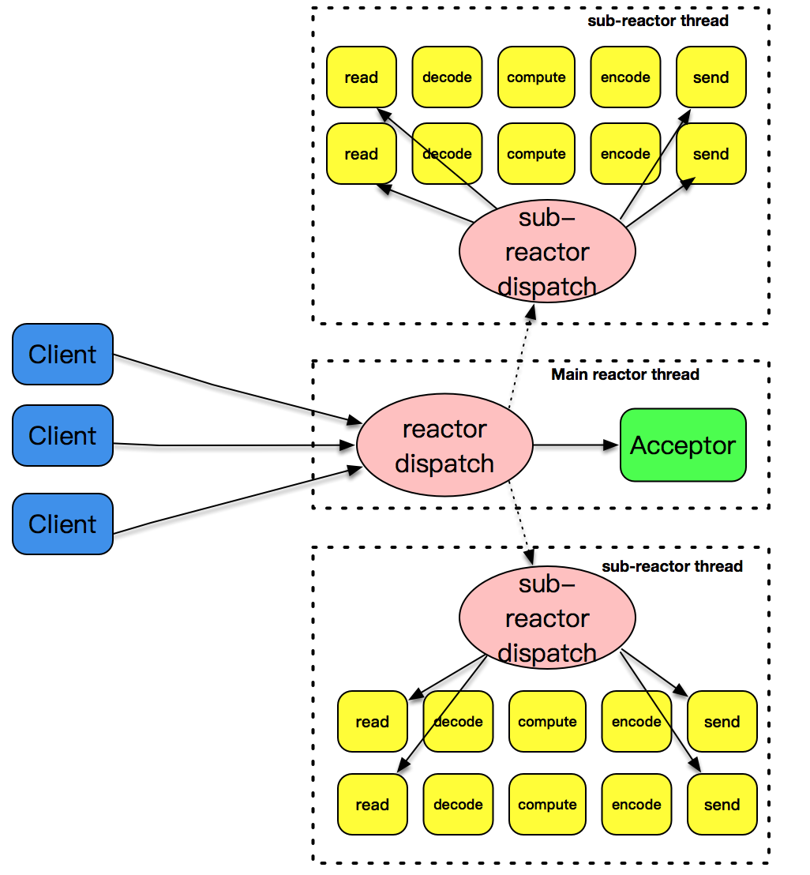
Muduo Framework
Sinlge Server

Slide 8
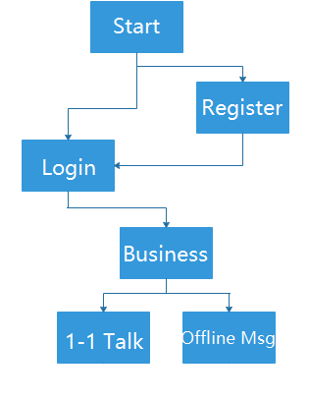
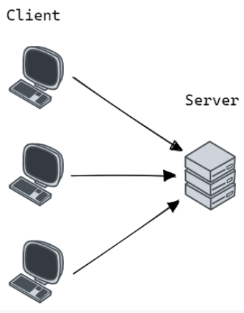
Events of Flow

Slide 9
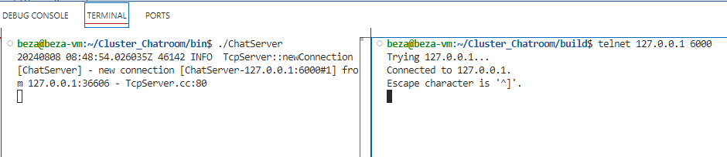
Connect to the server
Server Command:
$ ./ChatServer
20240808 07:13:18.904880Z 44957 INFO TcpServer::newConnection [ChatServer] - new connection [ChatServer-127.0.0.1:6000#1] from 127.0.0.1:42712 - TcpServer.cc:80
Client Command:
$ telnet 127.0.0.1 6000
Trying 127.0.0.1...
Connected to 127.0.0.1.
Escape character is '^]'.
Connection closed by foreign host.

Slide 10
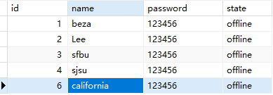
Registration
Server Command:
$ ./ChatServer
20240808 07:13:18.904880Z 44957 INFO TcpServer::newConnection [ChatServer] - new connection [ChatServer-127.0.0.1:6000#1] from 127.0.0.1:42712 - TcpServer.cc:80
20240808 08:50:09.824434Z 46143 INFO /home/beza/Cluster_Chatroom/src/server/db/db.cpp:31:connect MySQL SUCCESS! - db.cpp:31
Client Command:
$ telnet 127.0.0.1 6000
Trying 127.0.0.1...
Connected to 127.0.0.1.
Escape character is '^]'.
Connection closed by foreign host.
{"msgid":3, "name":"california", "password":"123456"}
{"errno":0,"id":6,"msgid":4}

Slide 11
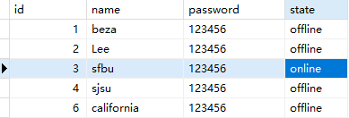
Login
Server Command:
$ ./ChatServer
20240808 07:13:18.904880Z 44957 INFO TcpServer::newConnection [ChatServer] - new connection [ChatServer-127.0.0.1:6000#1] from 127.0.0.1:42712 - TcpServer.cc:80
20240808 08:53:08.460387Z 46398 INFO /home/beza/Cluster_Chatroom/src/server/db/db.cpp:31:connect MySQL SUCCESS! - db.cpp:31
20240808 08:53:08.472391Z 46398 INFO /home/beza/Cluster_Chatroom/src/server/db/db.cpp:31:connect MySQL SUCCESS! - db.cpp:31
20240808 08:53:08.484893Z 46398 INFO /home/beza/Cluster_Chatroom/src/server/db/db.cpp:31:connect MySQL SUCCESS! - db.cpp:31
Client Command:
$ telnet 127.0.0.1 6000
Trying 127.0.0.1...
Connected to 127.0.0.1.
Escape character is '^]'.
Connection closed by foreign host.
{"msgid":1, "id":3, "password":"123456"}
{"errno":0,"id":3,"msgid":2,"name":"sfbu"}

Slide 12
1-1 Chat
Server Command:
$ ./ChatServer
20240808 08:56:34.718951Z 46605 INFO TcpServer::newConnection [ChatServer] - new connection [ChatServer-127.0.0.1:6000#1] from 127.0.0.1:56638 - TcpServer.cc:80
20240808 08:57:18.354496Z 46605 INFO TcpServer::newConnection [ChatServer] - new connection [ChatServer-127.0.0.1:6000#2] from 127.0.0.1:57316 - TcpServer.cc:80
20240808 08:57:41.562821Z 46606 INFO /home/beza/Cluster_Chatroom/src/server/db/db.cpp:31:connect MySQL SUCCESS! - db.cpp:31
20240808 08:57:41.573988Z 46606 INFO /home/beza/Cluster_Chatroom/src/server/db/db.cpp:31:connect MySQL SUCCESS! - db.cpp:31
20240808 08:57:41.587967Z 46606 INFO /home/beza/Cluster_Chatroom/src/server/db/db.cpp:31:connect MySQL SUCCESS! - db.cpp:31
20240808 08:57:51.317376Z 46607 INFO /home/beza/Cluster_Chatroom/src/server/db/db.cpp:31:connect MySQL SUCCESS! - db.cpp:31
20240808 08:57:51.327311Z 46607 INFO /home/beza/Cluster_Chatroom/src/server/db/db.cpp:31:connect MySQL SUCCESS! - db.cpp:31
20240808 08:57:51.340924Z 46607 INFO /home/beza/Cluster_Chatroom/src/server/db/db.cpp:31:connect MySQL SUCCESS! - db.cpp:31
Client-1 Terminal:
$ telnet 127.0.0.1 6000
Trying 127.0.0.1...
Connected to 127.0.0.1.
Escape character is '^]'.
{"msgid":1, "id":3, "password":"123456"}
{"errno":0,"id":3,"msgid":2,"name":"sfbu"}
{"msgid":5, "id":3, "from":"sfbu", "to":4, "msg":"Good morning!"}
{"from":"sjsu","id":4,"msg":"Woooowwww!","msgid":5,"to":3}
Client-2 Terminal:
$ telnet 127.0.0.1 6000
Trying 127.0.0.1...
Connected to 127.0.0.1.
Escape character is '^]'.
{"msgid":1, "id":4, "password":"123456"}
{"errno":0,"id":4,"msgid":2,"name":"sjsu"}
{"from":"sfbu","id":3,"msg":"Good morning!","msgid":5,"to":4}
{"msgid":5, "id":4, "from":"sjsu", "to":3, "msg":"Woooowwww!"}

Slide 13
Offline Message
Server Command:
./ChatServer
20240808 09:02:43.412026Z 47096 INFO TcpServer::newConnection [ChatServer] - new connection [ChatServer-127.0.0.1:6000#1] from 127.0.0.1:48788 - TcpServer.cc:80
20240808 09:02:58.245100Z 47097 INFO /home/beza/Cluster_Chatroom/src/server/db/db.cpp:31:connect MySQL SUCCESS! - db.cpp:31
20240808 09:02:58.257223Z 47097 INFO /home/beza/Cluster_Chatroom/src/server/db/db.cpp:31:connect MySQL SUCCESS! - db.cpp:31
20240808 09:02:58.270748Z 47097 INFO /home/beza/Cluster_Chatroom/src/server/db/db.cpp:31:connect MySQL SUCCESS! - db.cpp:31
20240808 09:03:15.174516Z 47097 INFO /home/beza/Cluster_Chatroom/src/server/db/db.cpp:31:connect MySQL SUCCESS! - db.cpp:31
20240808 09:03:26.051819Z 47097 INFO /home/beza/Cluster_Chatroom/src/server/db/db.cpp:31:connect MySQL SUCCESS! - db.cpp:31
20240808 09:03:37.457690Z 47096 INFO TcpServer::newConnection [ChatServer] - new connection [ChatServer-127.0.0.1:6000#2] from 127.0.0.1:55802 - TcpServer.cc:80
20240808 09:03:50.906186Z 47098 INFO /home/beza/Cluster_Chatroom/src/server/db/db.cpp:31:connect MySQL SUCCESS! - db.cpp:31
20240808 09:03:50.918361Z 47098 INFO /home/beza/Cluster_Chatroom/src/server/db/db.cpp:31:connect MySQL SUCCESS! - db.cpp:31
20240808 09:03:50.932258Z 47098 INFO /home/beza/Cluster_Chatroom/src/server/db/db.cpp:31:connect MySQL SUCCESS! - db.cpp:31
20240808 09:03:50.943100Z 47098 INFO /home/beza/Cluster_Chatroom/src/server/db/db.cpp:31:connect MySQL SUCCESS! - db.cpp:31
Client-1 Terminal:
$ telnet 127.0.0.1 6000
Trying 127.0.0.1...
Connected to 127.0.0.1.
Escape character is '^]'.
{"msgid":1, "id":3, "password":"123456"}
{"errno":0,"id":3,"msgid":2,"name":"sfbu"}
{"msgid":5, "id":3, "from":"sfbu", "to":4, "msg":"Offline: Wake up!"}
{"msgid":5, "id":3, "from":"sfbu", "to":4, "msg":"Offline: I am waiting for you!"}
Client-2 Terminal:
$ telnet 127.0.0.1 6000
Trying 127.0.0.1...
Connected to 127.0.0.1.
Escape character is '^]'.
{"msgid":1, "id":4, "password":"123456"}
{"errno":0,"id":4,"msgid":2,"name":"sjsu","offlinemsg":["{\"from\":\"sfbu\",\"id\":3,\"msg\":\"Offline: Wake up!\",\"msgid\":5,\"to\":4}","{\"from\":\"sfbu\",\"id\":3,\"msg\":\"Offline: I am waiting for you!\",\"msgid\":5,\"to\":4}"]}

Slide 14
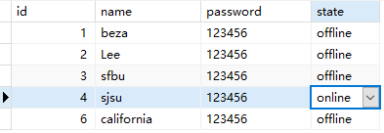
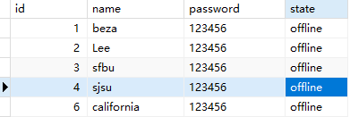
Reset
Server Command:
./ChatServer
20240808 09:10:24.146391Z 47679 INFO TcpServer::newConnection [ChatServer] - new connection [ChatServer-127.0.0.1:6000#1] from 127.0.0.1:34082 - TcpServer.cc:80
20240808 09:10:32.690565Z 47680 INFO /home/beza/Cluster_Chatroom/src/server/db/db.cpp:31:connect MySQL SUCCESS! - db.cpp:31
20240808 09:10:32.702618Z 47680 INFO /home/beza/Cluster_Chatroom/src/server/db/db.cpp:31:connect MySQL SUCCESS! - db.cpp:31
20240808 09:10:32.718241Z 47680 INFO /home/beza/Cluster_Chatroom/src/server/db/db.cpp:31:connect MySQL SUCCESS! - db.cpp:31
exception caught in Thread ChatServer CTRL+C
reason: [json.exception.parse_error.101] parse error at line 1, column 1: syntax error while parsing value - invalid literal; last read: '�’ Aborted (core dumped)
Client-1 Terminal:
$ telnet 127.0.0.1 6000
Trying 127.0.0.1...
Connected to 127.0.0.1.
Escape character is '^]’.
{"msgid":1, "id":4, "password":"123456"}
{"errno":0,"id":4,"msgid":2,"name":"sjsu"}

Slide 15
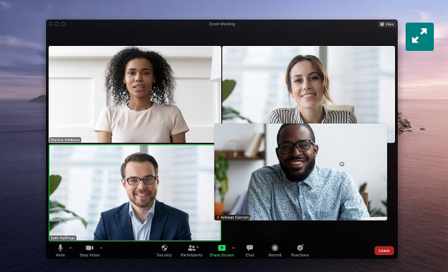
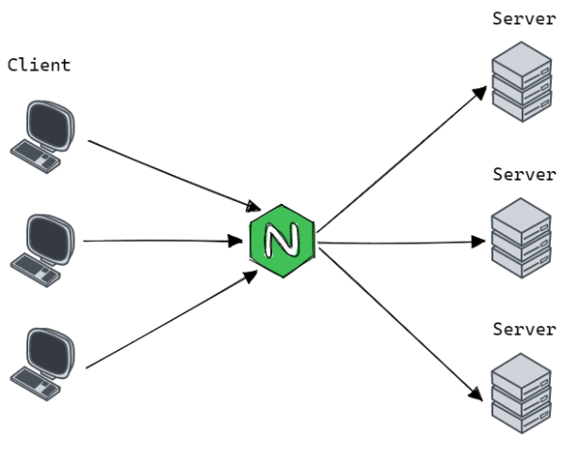
Future
TO DO:
Add Friends
Group Chat
Client Side
Cluster Setup

Slide 16
Reference
https://www.bilibili.com/video/BV1yM4m127ZF?p=1&vd_source=3353f83539e46042d8cf76efb177a8e4
Accessed: Jul 15, 2024

Slide 17
Thank You! Chufeng Jiang

